Slide 1
SMART RFID KAMSIS SYSTEM AT PTSS
Reported by:NURUL IZZAH `ATHIRAH BINTI ZAMURI MUHAMMAD HAFIZ BIN ZAKARIA
SUPERVISOR: ENCIK SABRI BIN SAEP

Slide 2
Content and Concept
of Project
PROBLEM STATEMENT
Each semester the room key will be reduced among residents kamsis because lost and negligence. This is a problem for the warden kamsis as difficult for a new manufacturing process for the next semester because each semester will turn new residents.There are some significant negative consequences if a key is not returned or are lost due to the negligence of both parties. One effect is the warden had to create a new key so that new residents can enter the room.

Slide 3
OBJECTIVE
to manage room facilities information
to control room authorization
to alert users about unlock doors

Slide 4
Progress of Project Development
Success Developing of the project using web based as input to the project.Moreover the system have 3 user such as Admin,Staff and Student.
At First, admin will update and delete all detail about students and staff can view student info and update facilities details.
Student can access room key with matrik cad.

Slide 5
INTERFACE ADMIN

Slide 6
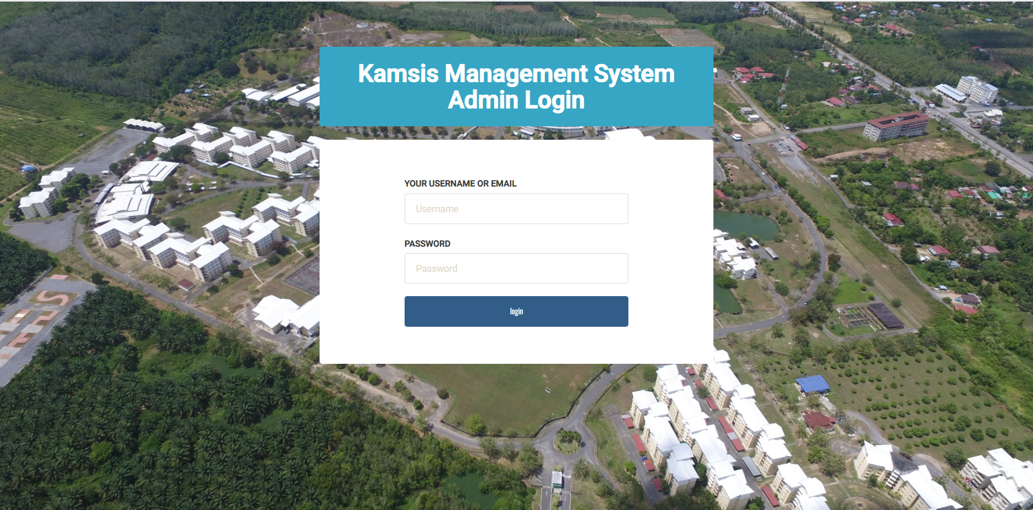

Slide 7
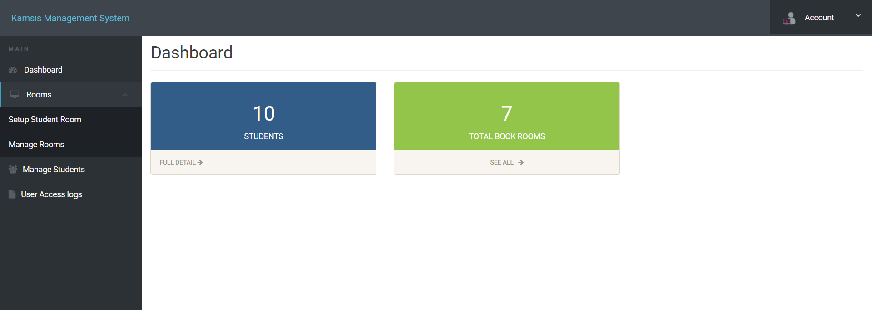

Slide 8
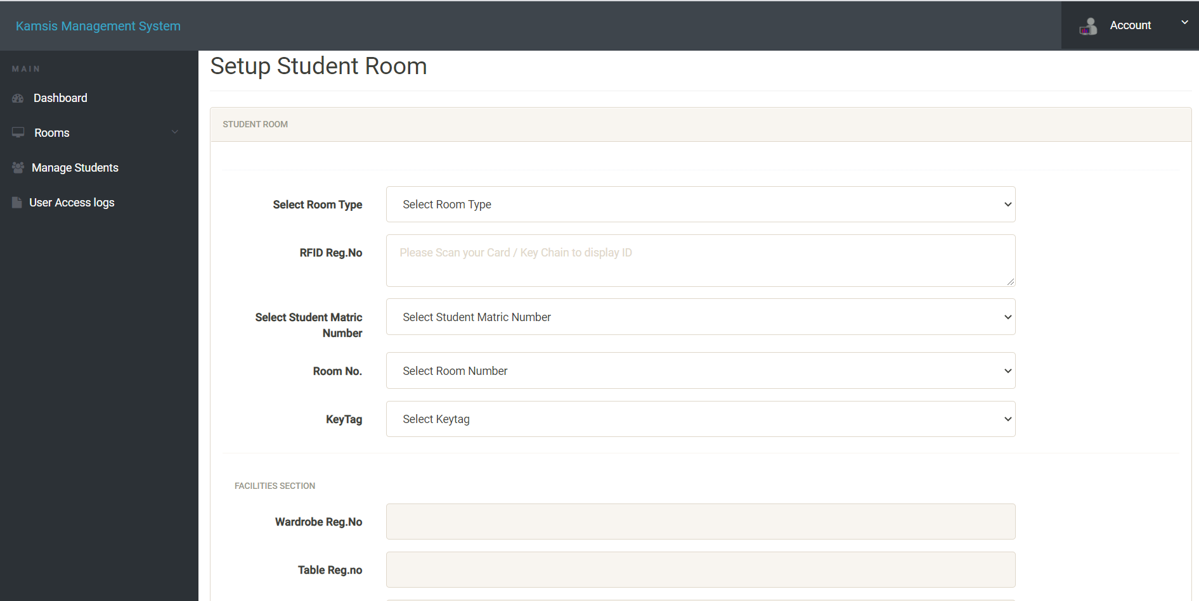

Slide 9
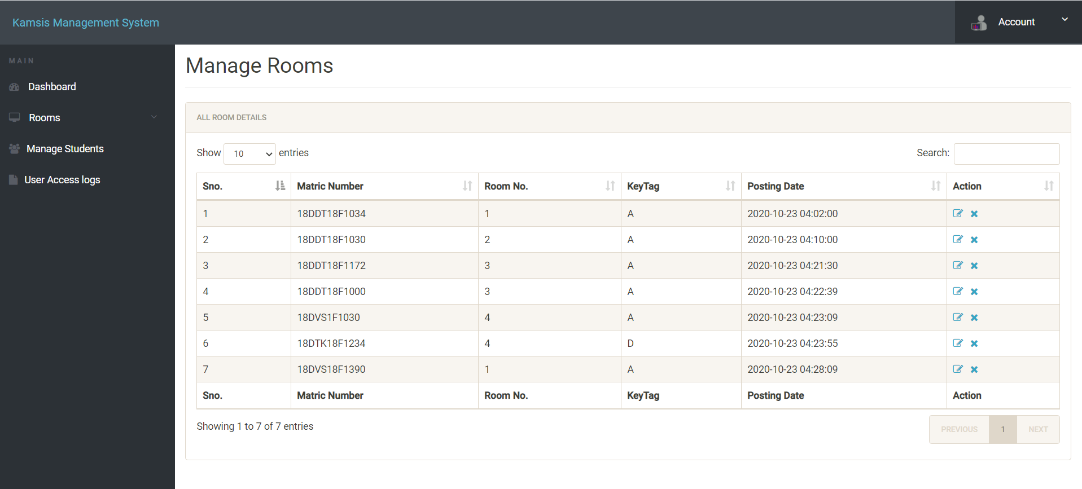

Slide 10
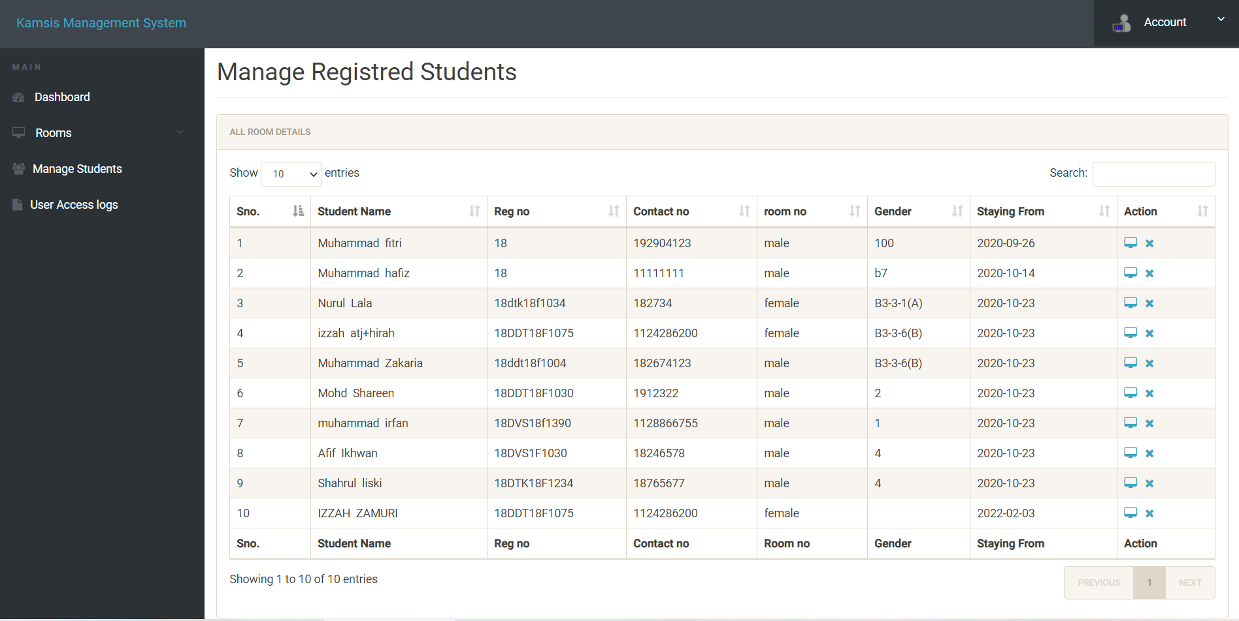

Slide 11
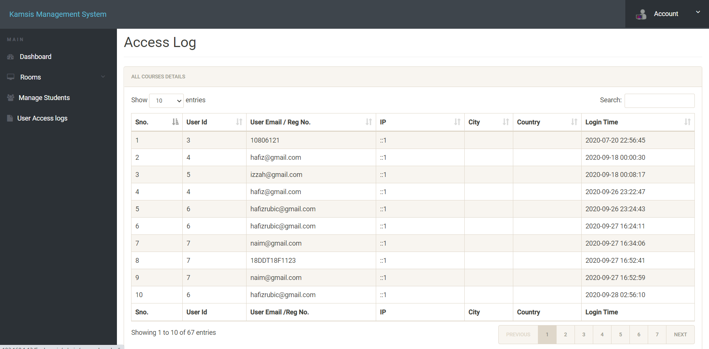

Slide 12
INTERFACE STAFF

Slide 13
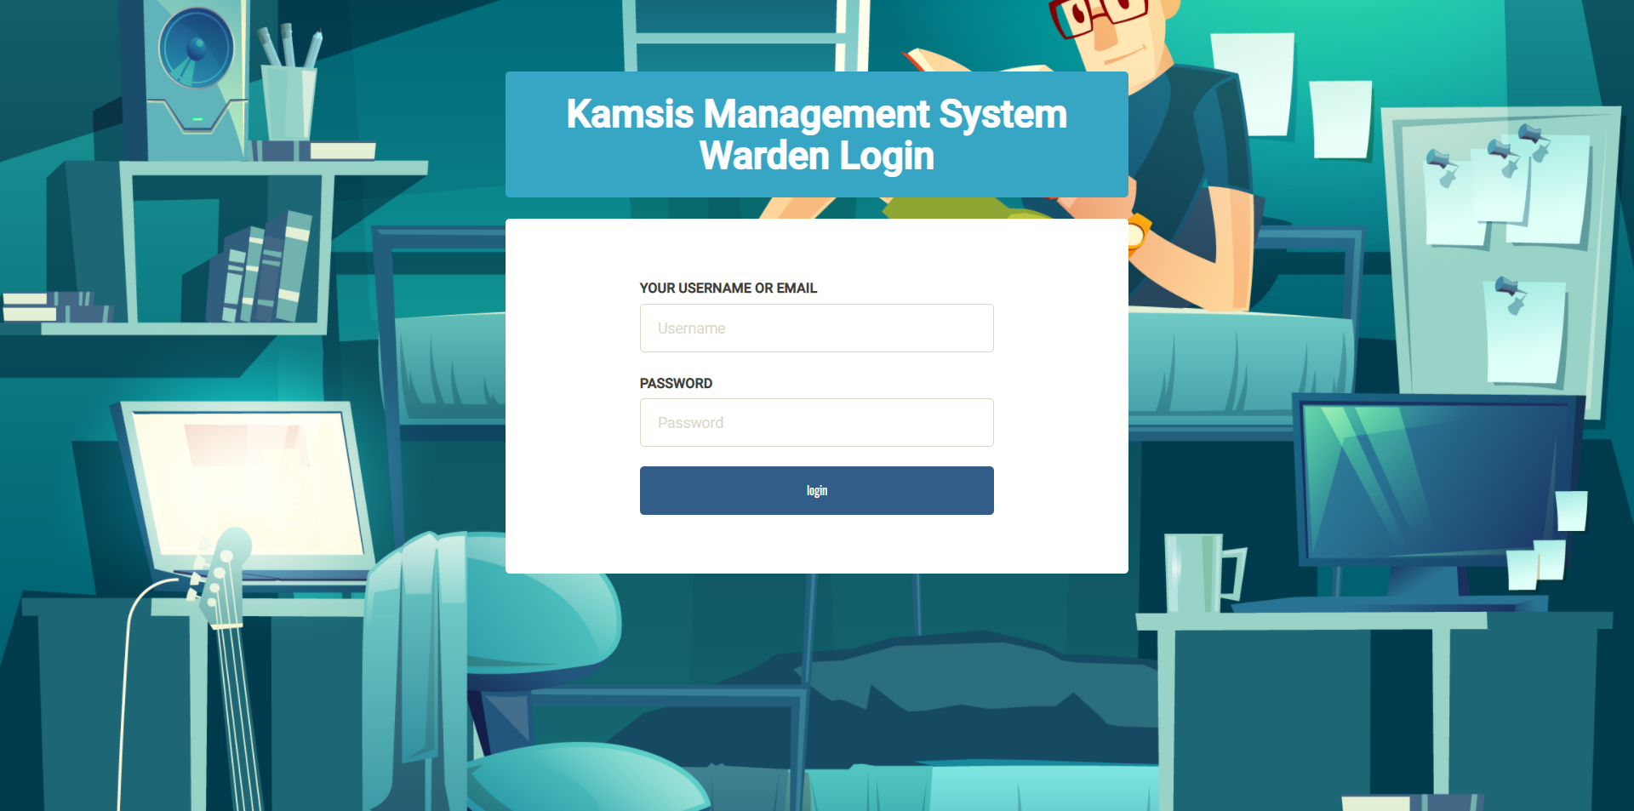

Slide 14
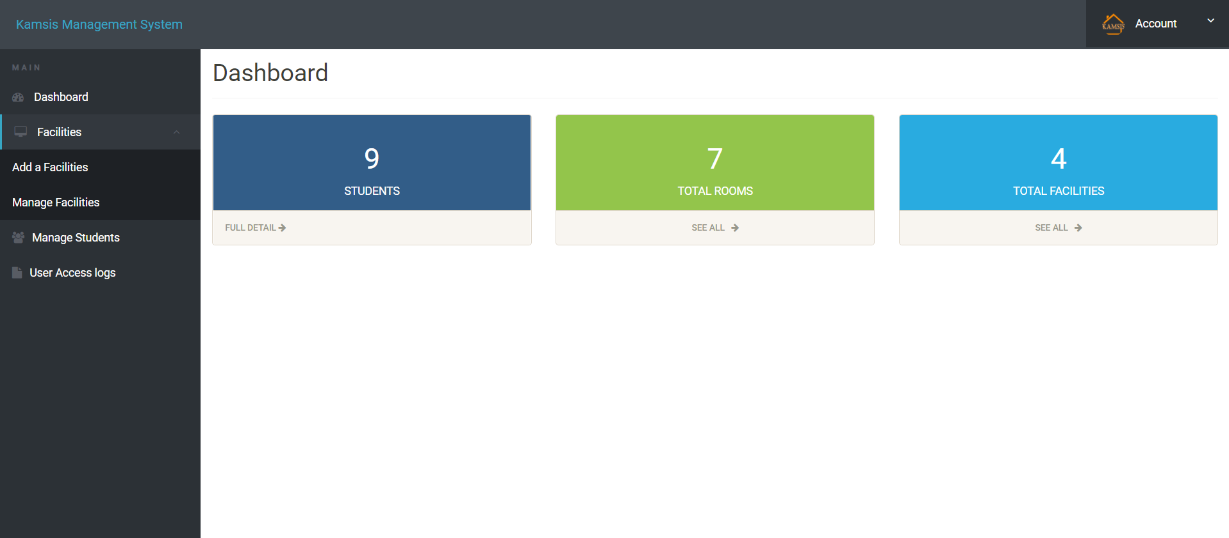

Slide 15
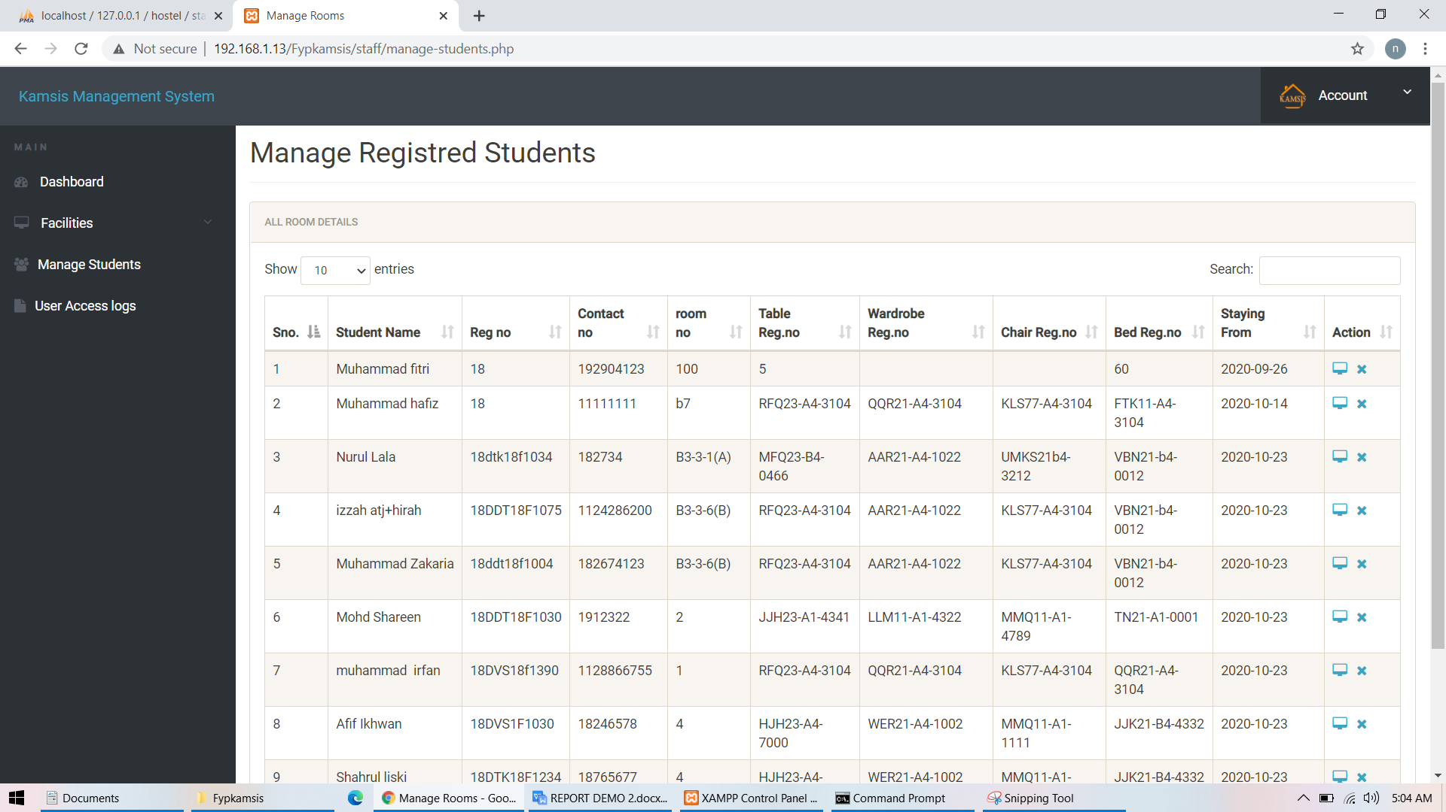

Slide 16
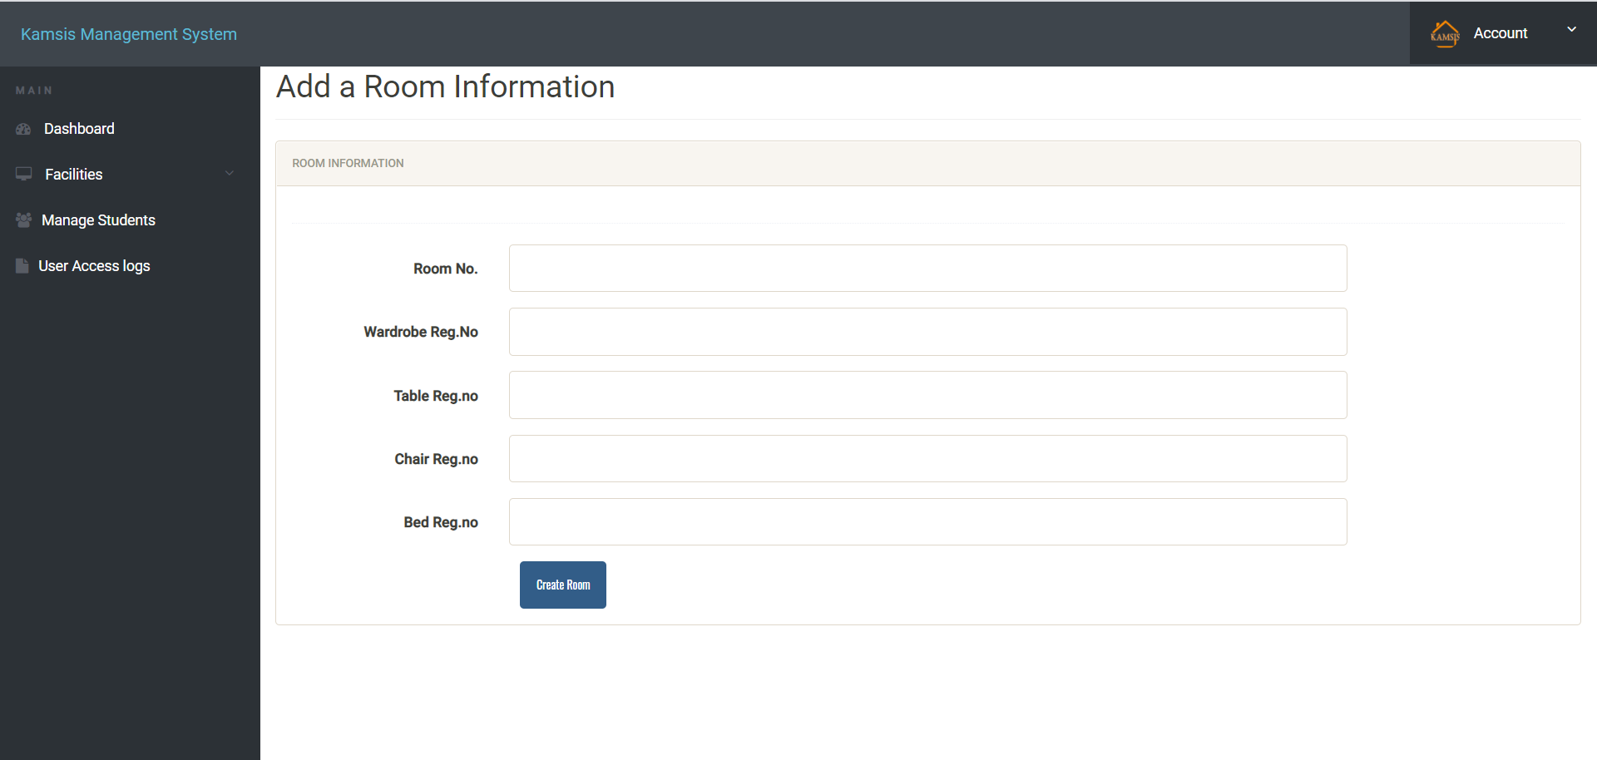

Slide 17
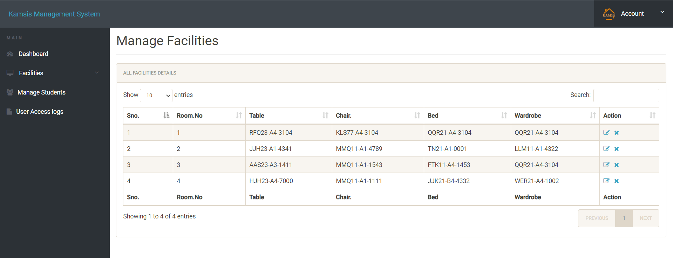

Slide 18
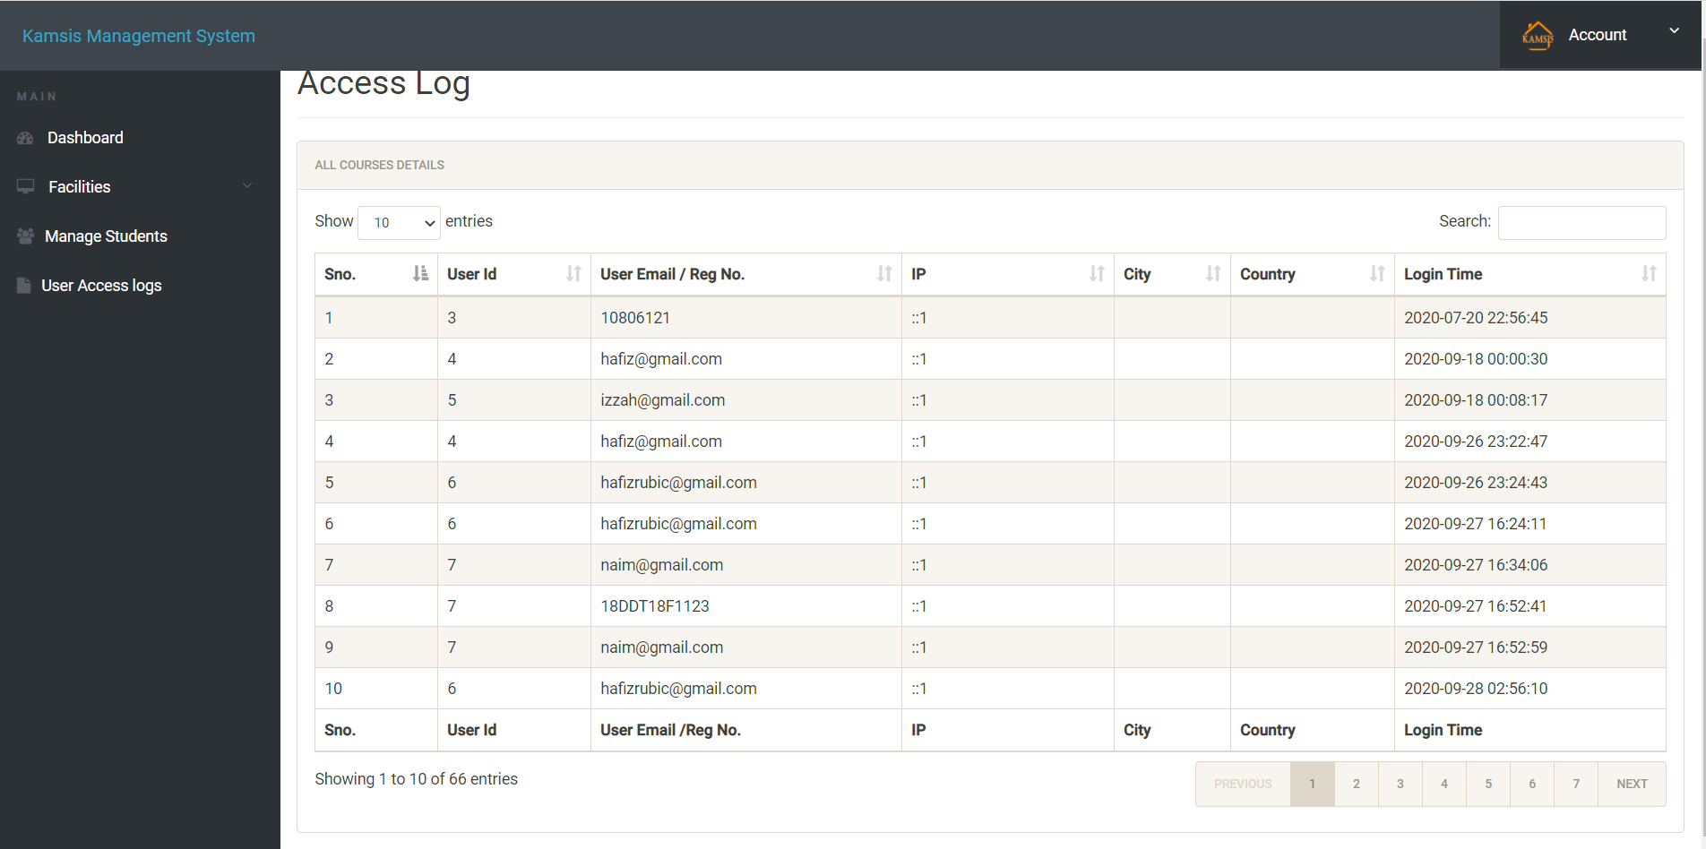

Slide 19
INTERFACE STUDENT

Slide 20
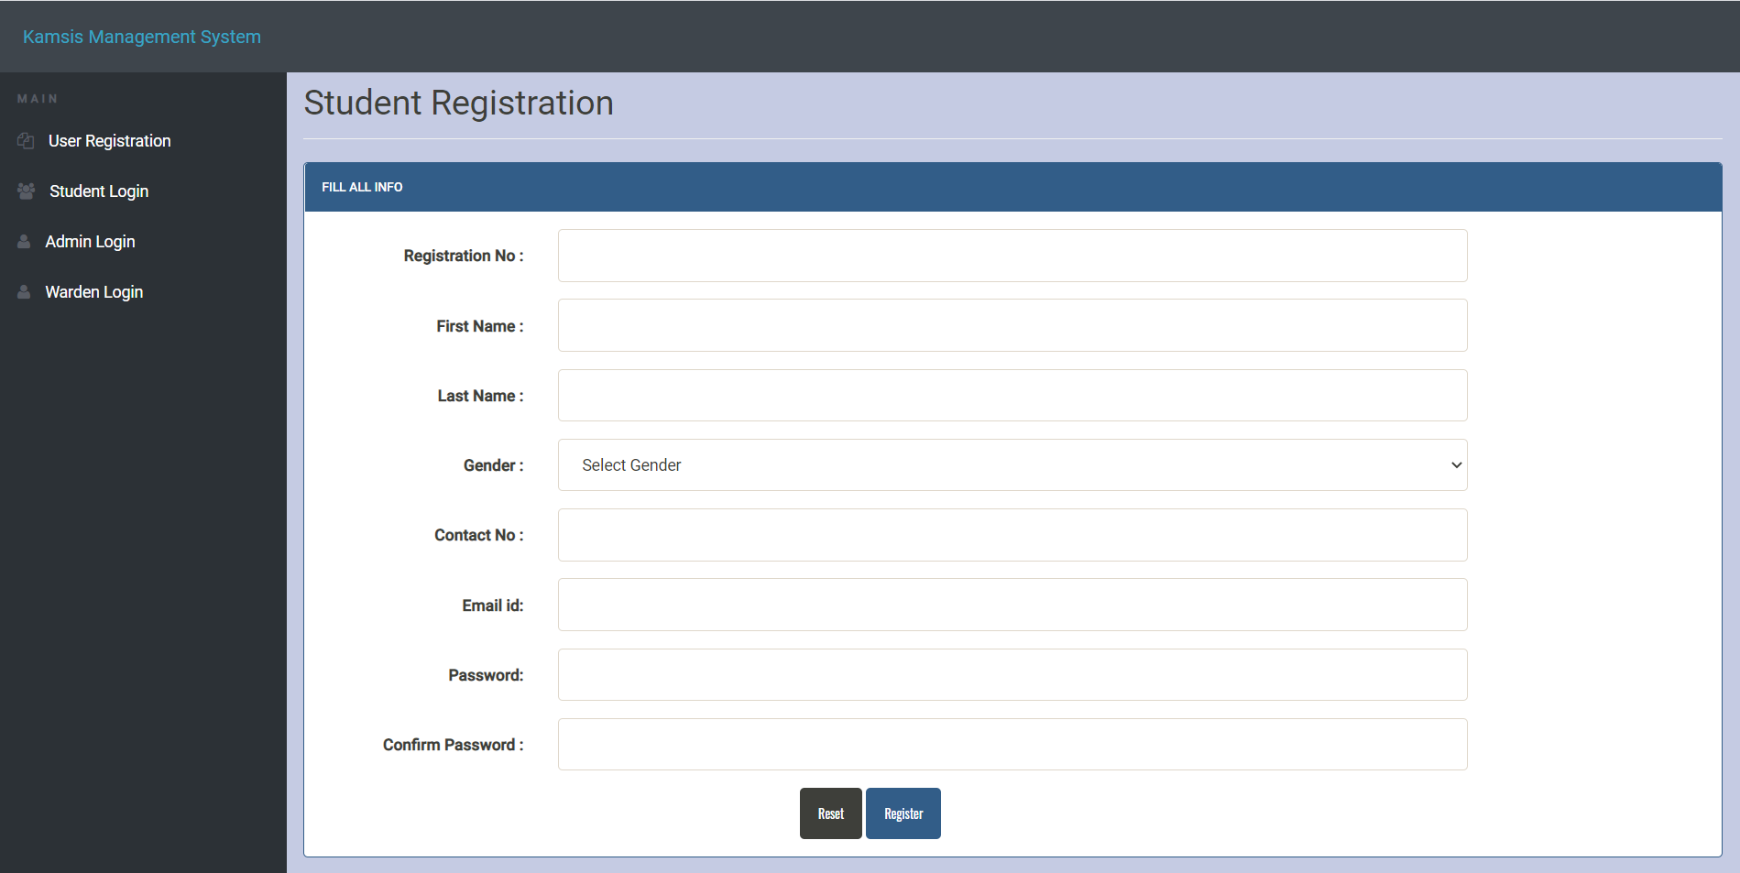

Slide 21
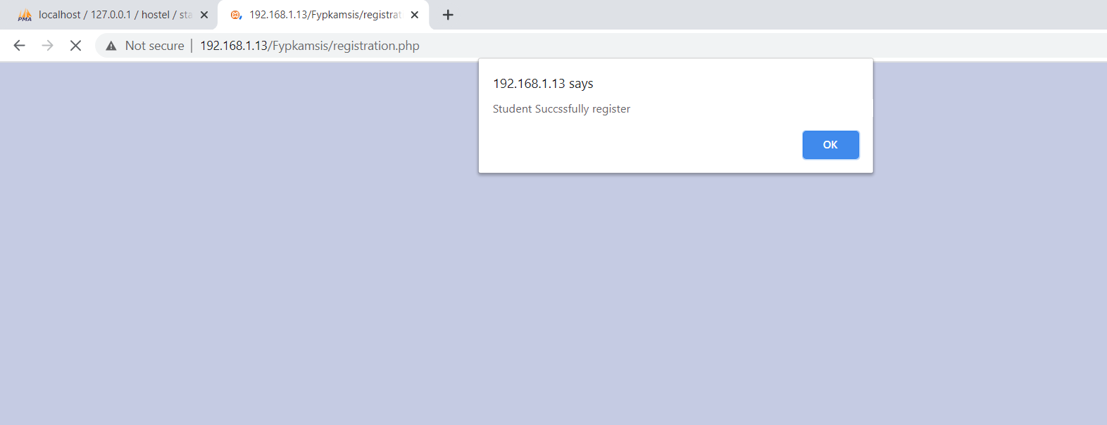

Slide 22
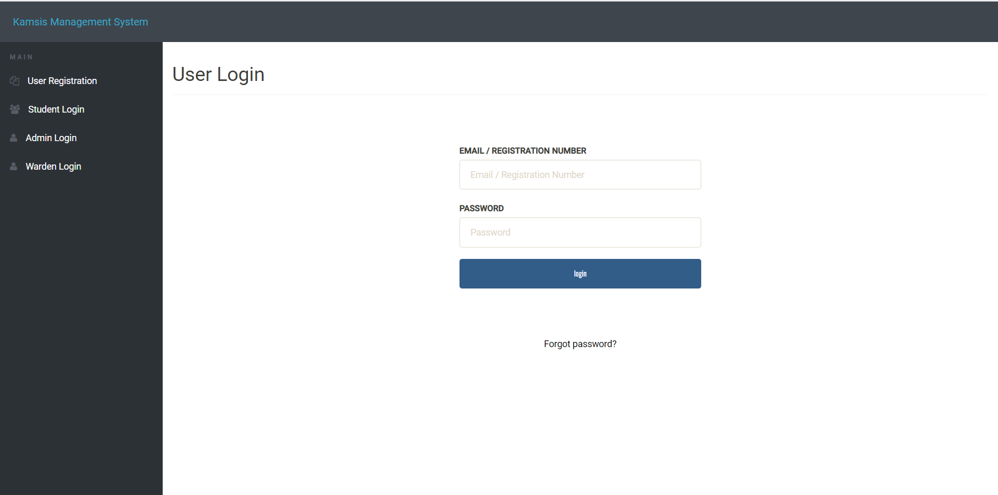

Slide 23
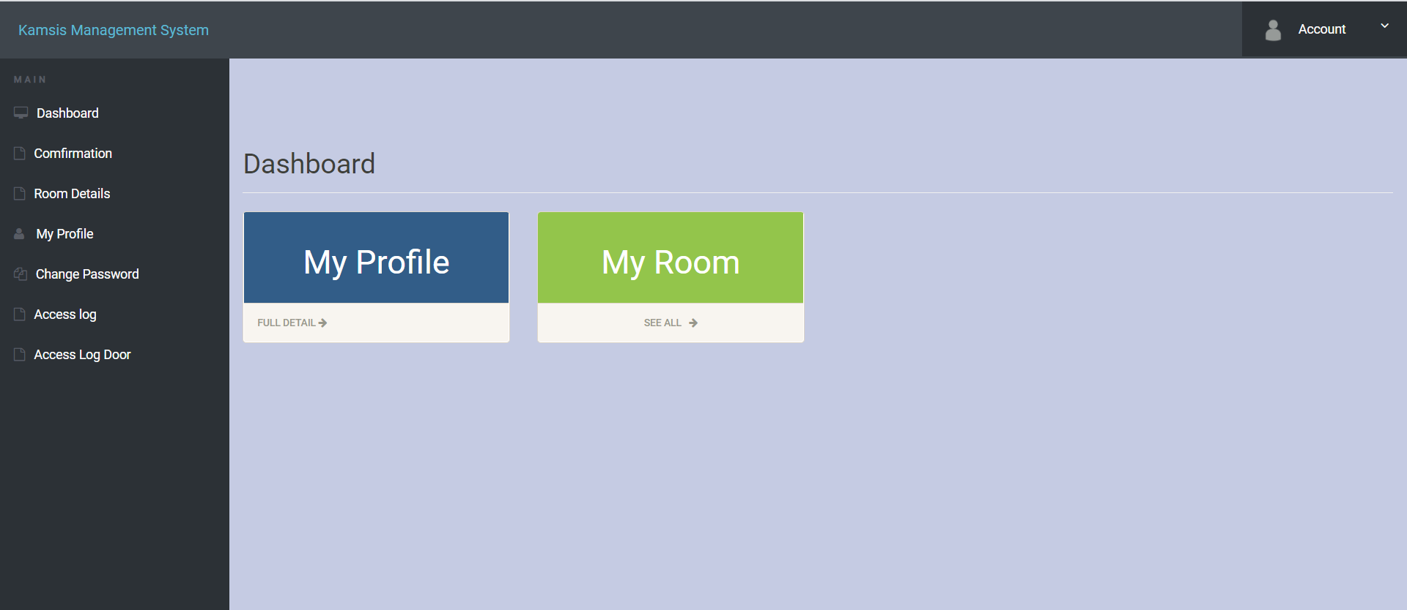

Slide 24
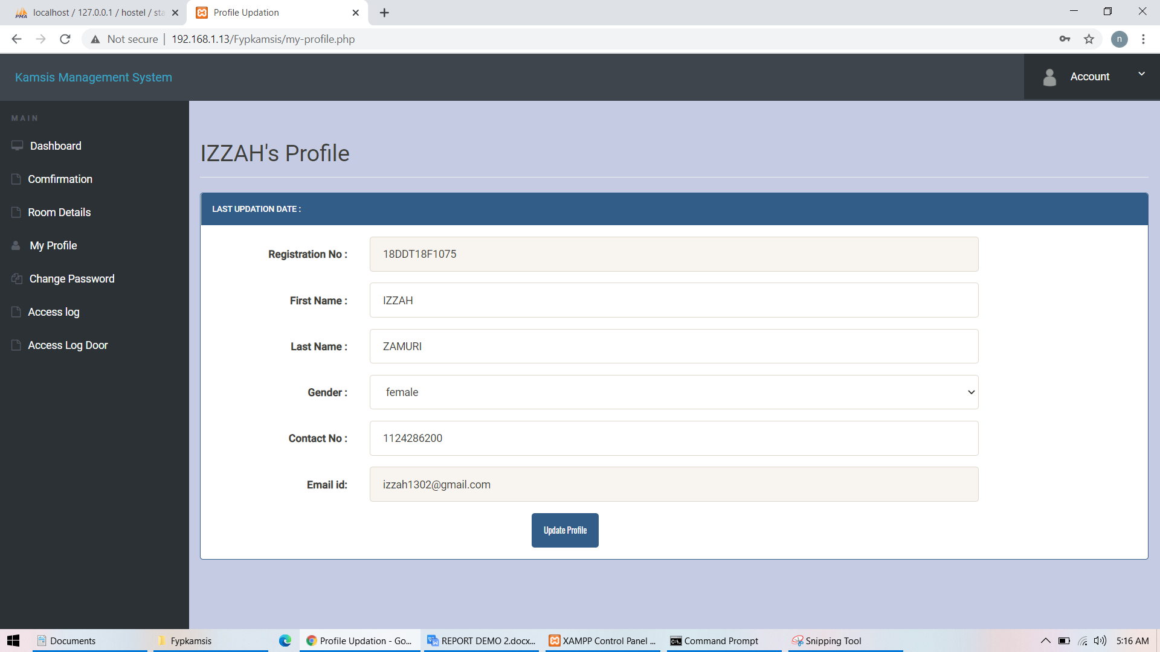

Slide 25
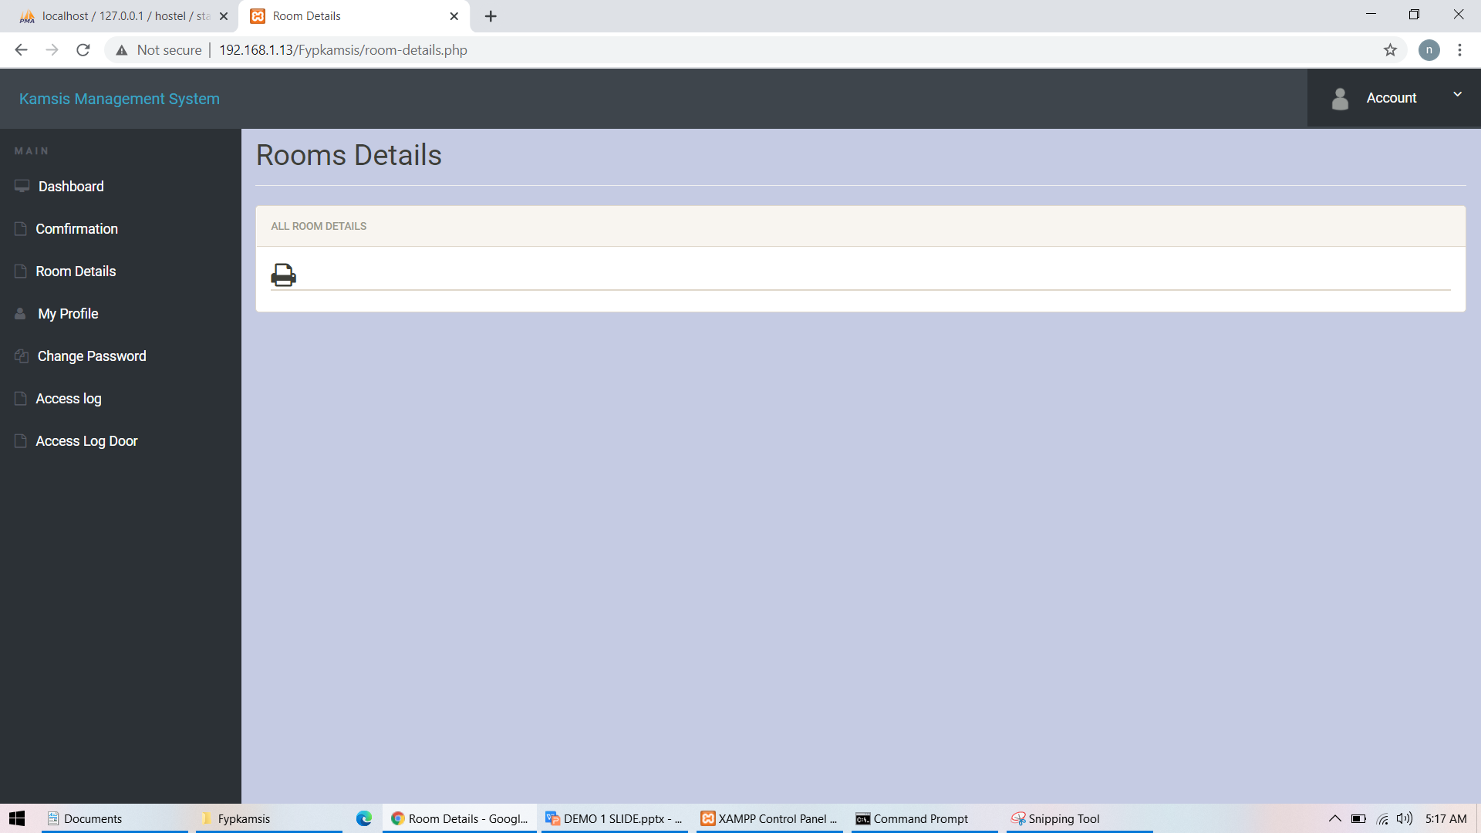

Slide 26
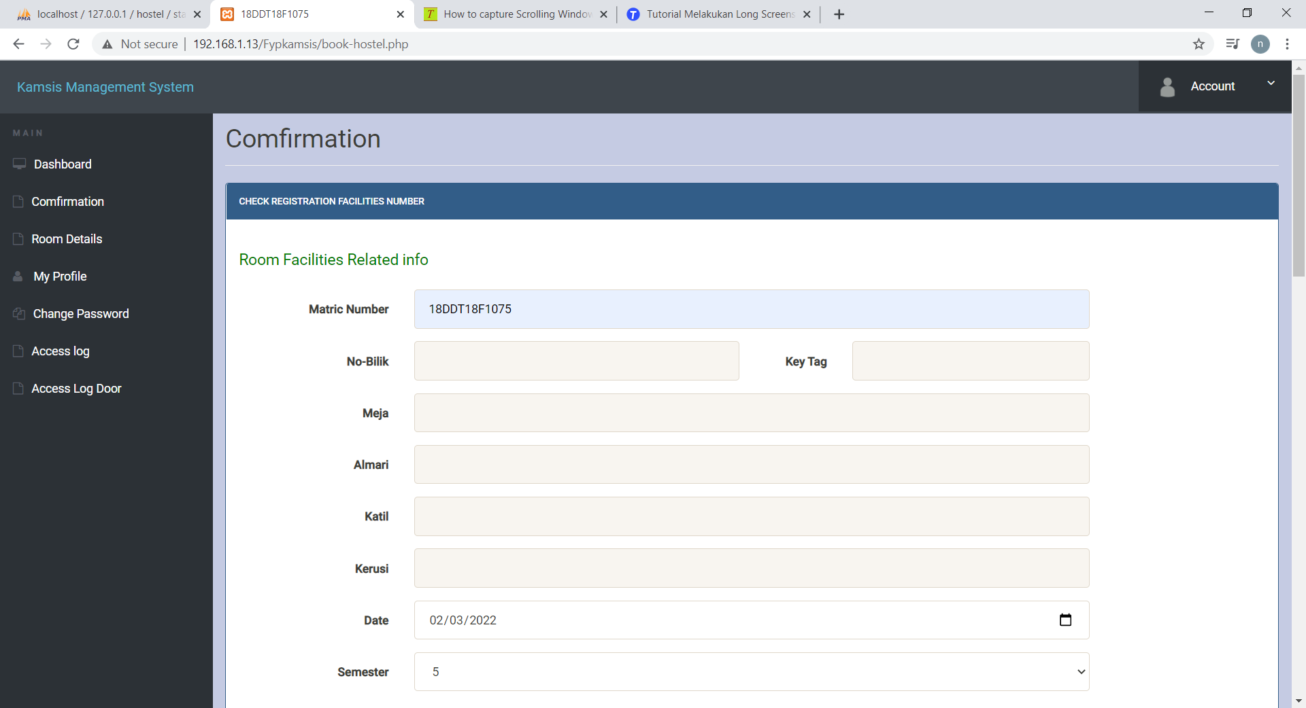

Slide 27
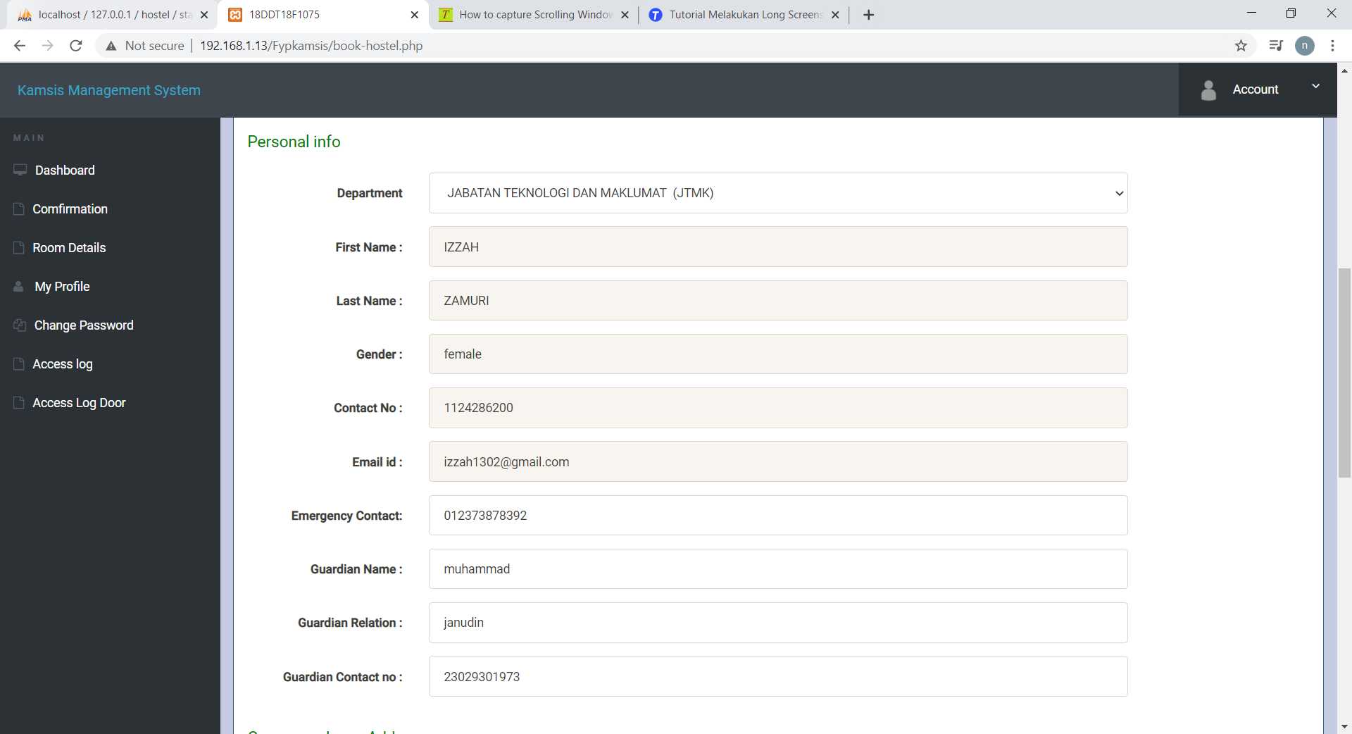

Slide 28
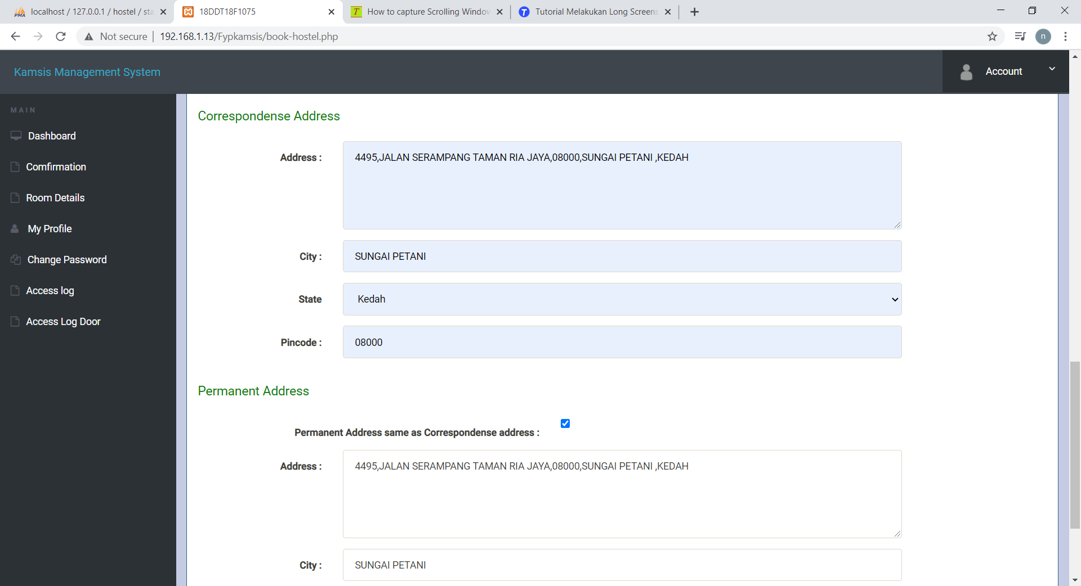

Slide 29
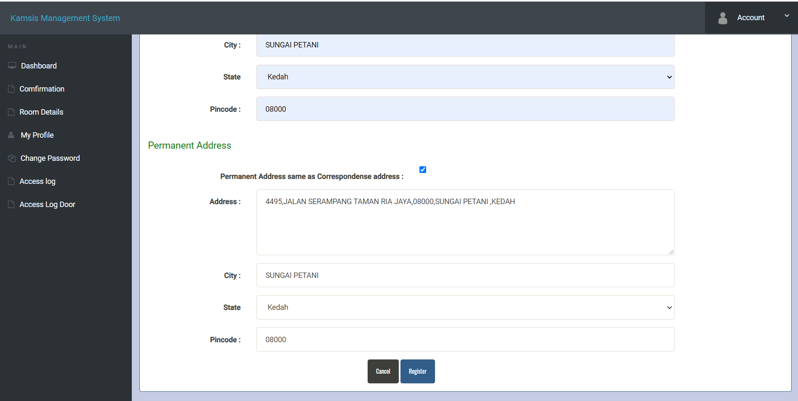

Slide 30
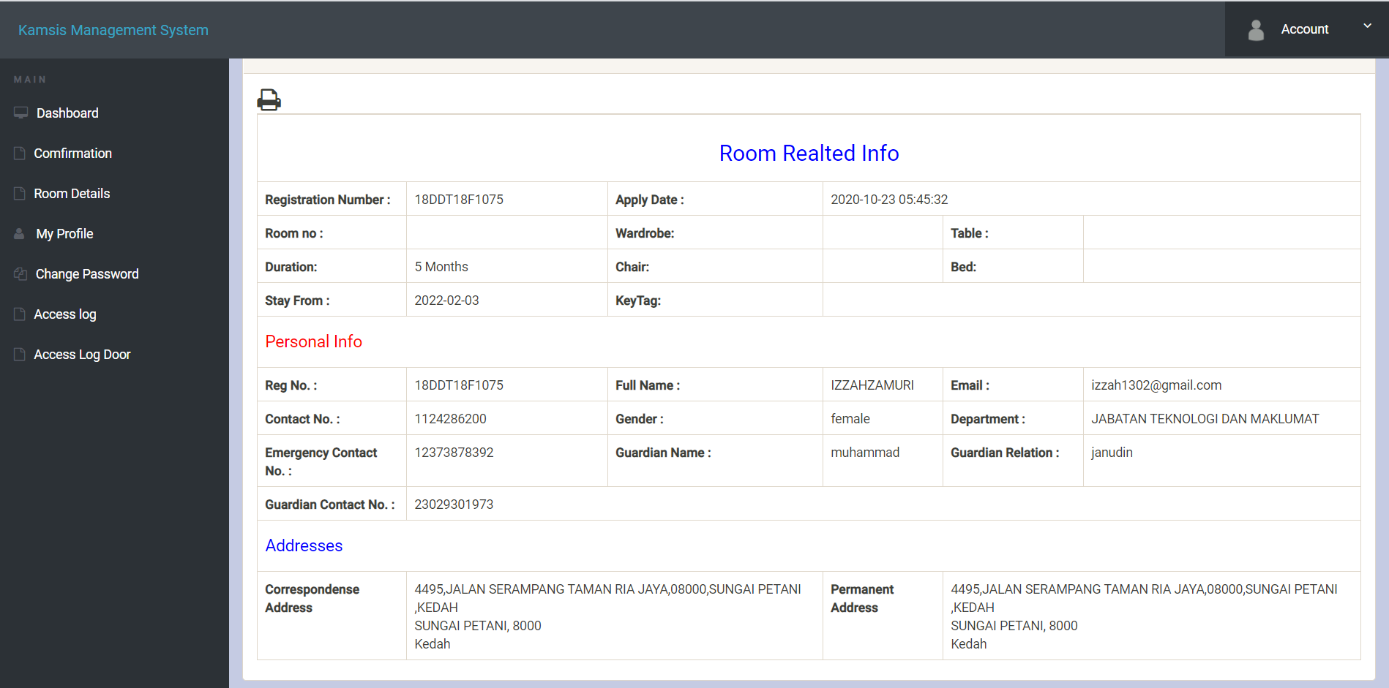

Slide 31
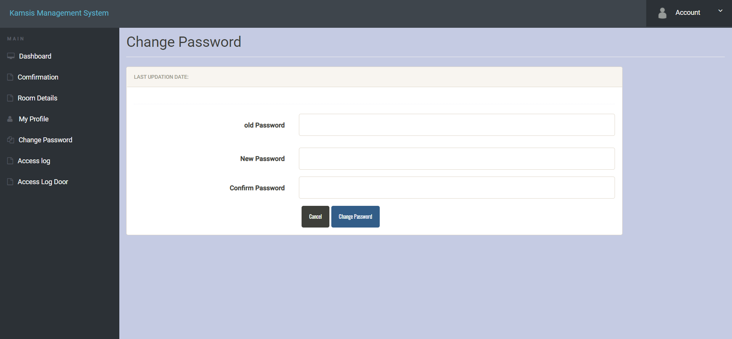

Slide 32
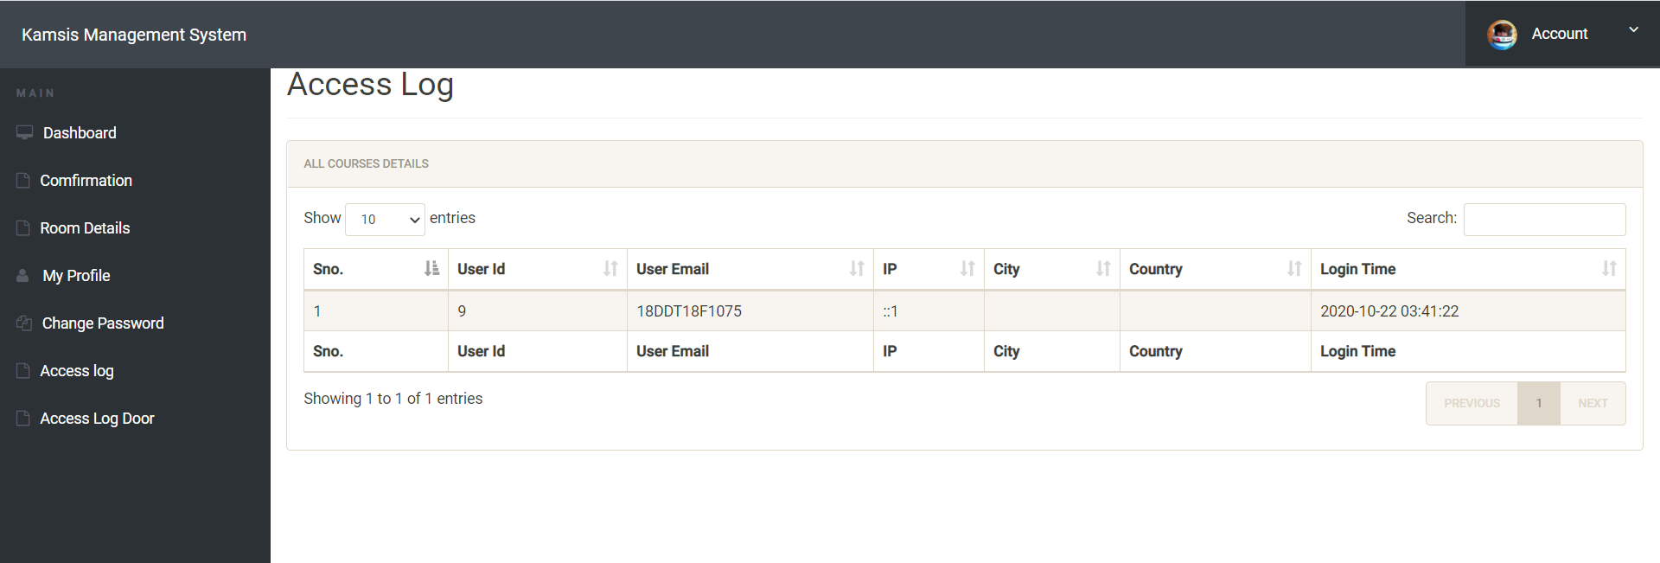

Slide 33
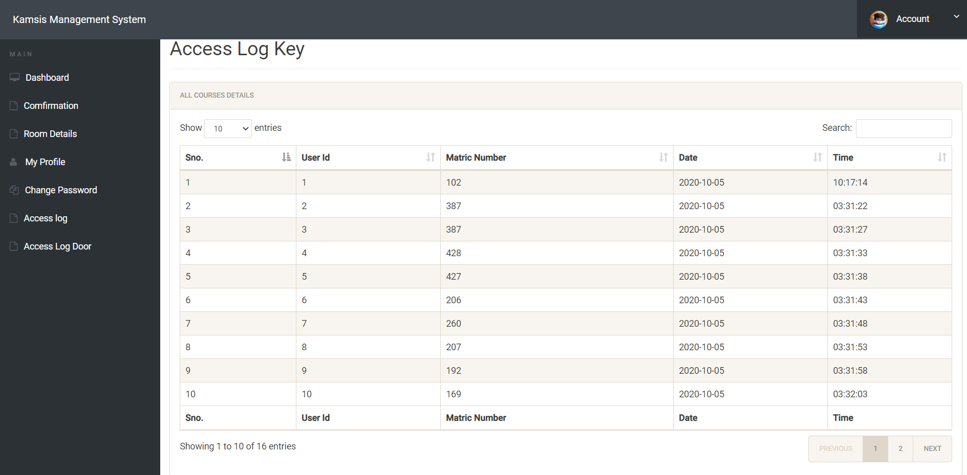

Slide 34
HARDWARE

Slide 35
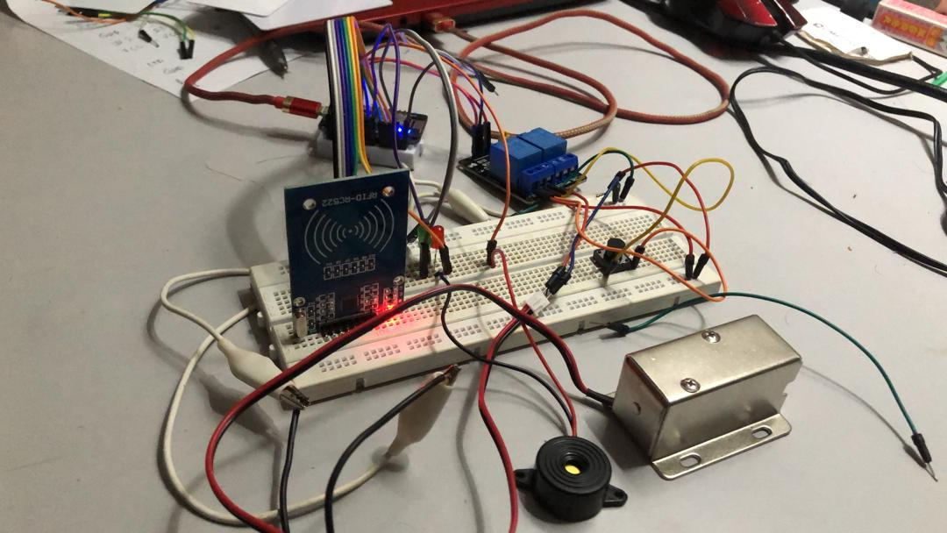
welcome
Enter your title here
Enter your title here
Enter your title here

Slide 36
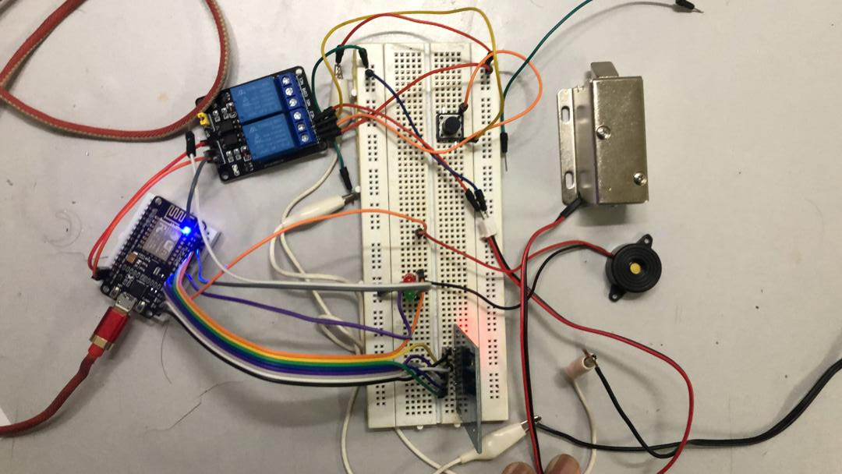

Slide 37
TESTING

Slide 38
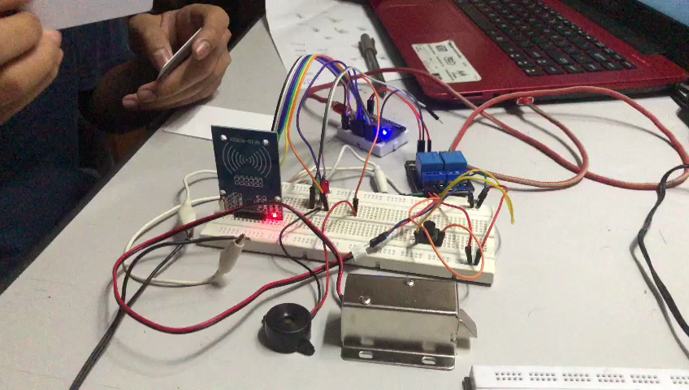

Slide 39
THANKS

